Slide 1
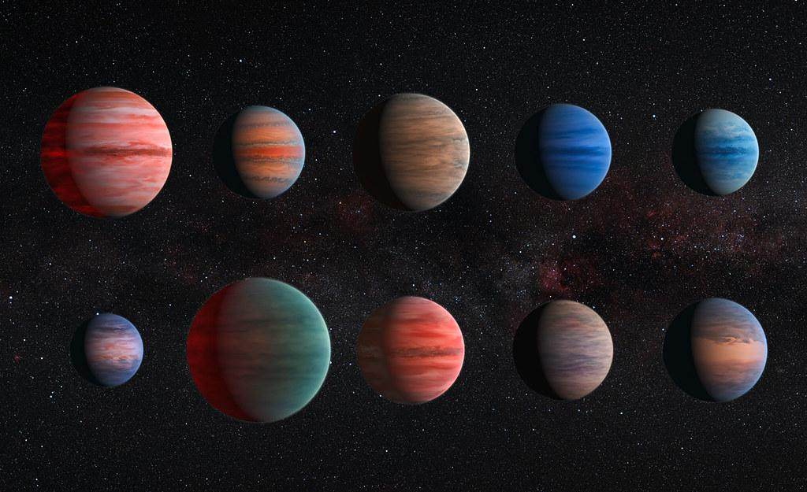
Exploring Exoplanet Properties
By: Daniel Zurawski, Victor Karkour and Jake Kamen

Slide 2
Introduction & Motivation
Intro:
Our exoplanet system: GJ 436 b
Explore how we measure exoplanet mass, radius, density
Using Radial Velocity and transit data
Compare data with M-R relation from Chen & Kipping (2016)
Explore abundance of types of exoplanets!
Some Questions We Look to Answer:
How can Radial Velocity measurements lead to a deeper understanding of the abundance of planet types in the Cosmos?
How do our measurements of mass and radius compare to other exoplanets of similar mass and radii?

Slide 3
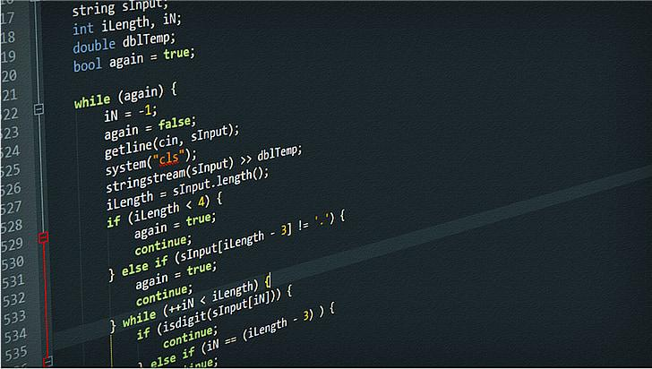
Methods
List of used Methods:
NEA for data collection
Google Colab for Python implementation
Uncertainty for Relative Flux Calculation
Lomb-Scargle Periodogram
RadVel python Package
Matplotlib for simple python plotting

Slide 4




Methods Continued…
Equations (shown on right):
K-value equation
Planet Mass equation
Kepler’s 3rd Law
Transit depth equation

Slide 5
Results
Mass:
Approximate mass = 20.003 Earth Masses
Using Uncertainties:
Mass range is 1.99963 M_earth
Radius:
Radius = 4.10156 Earth Radii
Using Uncertainties:
Radius range is 0.24674 Earth Radii
Density:
Density = 1.59297 g/cm^3
Uncertainty = 0.18585 g/cm^3
Successfully found our exoplanets mass from the radial velocity data and radius from transit data
Calculated uncertainties of each

Slide 6
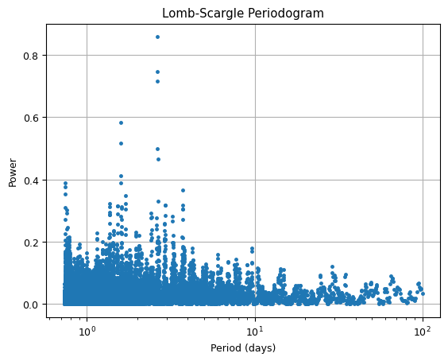
Results Continued…
Lomb-Scargle Periodogram (Graph 1)
Graph that determines period through unevenly spaced data
More data at smaller periods
Large spikes between 1-10
Largest spike at our period
future graphs (graph 2)
Leads to calculations for mass

Slide 7
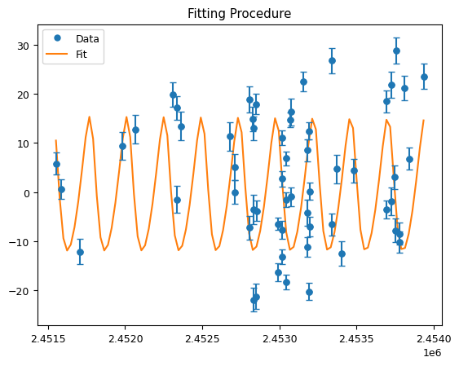
Results Continued…
RadVel (Graph 2)
“Fitting Procedure”
Clearly sinusoidal
Notice error bars
Led to us finding our Mass value

Slide 8
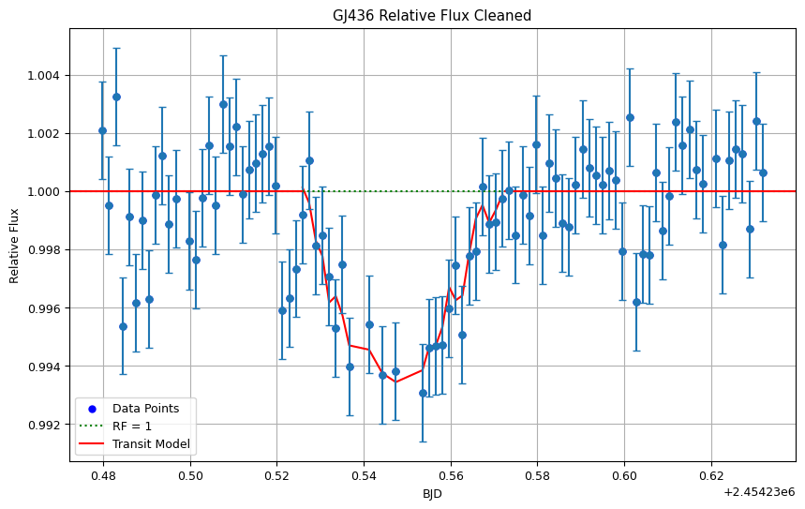
Results Continued…
Transit Light Curve (Graph 3)
Notice initial clear dip in middle of graph
Error Bars from standard deviation
This graph is “cleaned” (by 2𝜎)
Red line (transit model)
Clearly see transit depth
Leads to radius calculation

Slide 9
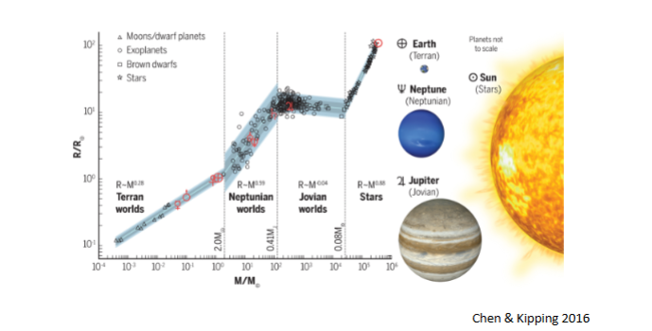
Chen and Kipping (2016)
Mass-radius relation from Chen and Kipping (2016)
Our measurement of mass = 20.003 Earth masses
Our measurement of radius = 0.3659 Jupiter Radii ~ 4 earth radii
Our measurements would put our planet in the Neptunian worlds section of the M-R relation (White circle)

Slide 10

Conclusion
We were able to successfully calculate the radius, mass, and density of our planet using RV and transit data.

